Slide 1
Object-Oriented Principles
Robustness
Notes:
Abstraction – Separating out a section of code into a reusable function or class; Also, an abstract class interface.
Encapsulation – Hiding implementation details to reduce dependencies from outside sources and increase robustness.
Modularity – Small pieces of a software solution which are self-sufficient add to its modularity.
Hierarchy – Reusing existing functionality by defining a relationship between two classes; most typically through inheritance or containment. Also describes the assignment or placement of responsibility.
Polymorphism – Utilizing different objects which exhibit a similar set of behaviors via a shared interface. (usually via virtual function table in C++) Aka treating an object at the appropriate level of inheritance for a given set of operations.

Slide 2
Robustness
Designing software in a way that facilitates future changes.
Notes:
Computer programs, in large part, are specialized and not robust. It is up to the software engineer to prioritize robustness, where others may instead choose to prioritize scalability or efficiency.

Slide 3
Encapsulation
Design clean abstractions; hide implementation details.
What does encapsulation afford us?
A more robust design
Localized refactoring
Notes:
Encapsulation is about the interface to an object, the data contained within, and the dependencies that result.
The reason for encapsulation is to prevent clients of an interface from depending on those parts of the implementation that are likely to change in the future, thereby allowing those changes to be made more easily, that is, without changes to those clients.

Slide 4
Abstraction
What is abstraction?
Notes:
Abstraction is a verb and a noun.
Abstraction is the process of abstracting and can also refer to the results of abstracting.
An abstraction is an interface created for defining how communication should happen to a class or set of classes. It can also refer to an individual function in a class.

Slide 5
Interfaces
Developing to an Interface (aka Contract)
class Projectile {
Vec2f position, velocity;
public:
Projectile (const Projectile &other);
void Update();
void SetVelocity(Vec2f);
void SetPosition(Vec2f);
};
Notes:
White-Box and Black-Box refer to the level of visibility one class has to another class's internals. Black-Box is use only through the public interface of the object. White-Box breaks encapsulation boundaries by allowing potential dependency on another class’s internal data or implementation details.
Some examples of White-Box relationships in C++ include inheritance relationships (protected), friend class relationships, and a class’s relationship to itself. For the last one we refer to its ability to look inside another same-type object or when implementation for a class bypasses using its own interface functions to access data.

Slide 6
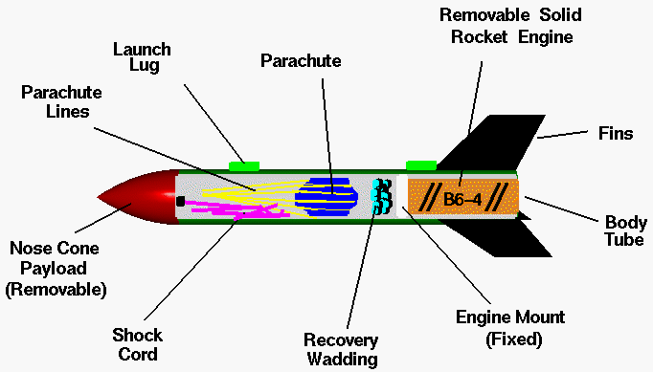
Modularity
Modularity is the property of computer programs that measures the extent to which they have been composed out of separate parts called modules.
Notes:
If a piece of software is modular, we should be able to replace one module with a similar module and the software should still work correctly.
Programs that have many direct interrelationships between any two random parts of the program code are less modular (more tightly coupled) than programs where those relationships occur mainly at well-defined interfaces between modules. - Wikipedia

Slide 7
Modularity
What does modularity afford us?
Separation of Concerns
More flexibility (through composition)
Notes:
Prefer components over inheritance:
Cleaner architecture
Faster execution time and overhead
More flexibility
More encapsulated (focused) units

Slide 8
Modularity - Helper Classes
When you have a class with a bunch of methods which can be possibly compartmentalized, try making helper classes to abstract the design a little bit.
These helper classes could be separate entities or even nested classes.
Notes:
By creating helper classes you are separating the concerns into more easily maintainable pieces as well as helping to increase the flexibility of the using class.
If an operation does not depend on class data, it is usually better to move it outside the class to tighten encapsulation of that class.
This kind of separation is commonly referred to as Levelization. (See Lakos – Large Scale C++ Software Design. Ch 5)

